Slide 1
Multimedia System and Virtual Environment
CSE – 310
Multimedia Networks
Dept. of Computer Science and Engineering, University of Rajshahi

Slide 2
Multimedia Networks
Lecture 16
Outline
RTP (Real Time Transport Protocol)
RTCP (Resource Time Control Protocol)
RTSP (Real Time Streaming Protocol)
RSVP (Resource ReSerVation Protocol)
Dept. of Computer Science and Engineering, University of Rajshahi

Slide 3
Multimedia Networks
Lecture 16
Real-Time Protocol (RTP)
RTP specifies packet structure for packets carrying audio, video data
RTP packet provides
payload type identification
packet sequence numbering
time stamping
RTP runs in end systems
RTP packets encapsulated in UDP segments
interoperability: if two Internet phone applications run RTP, then they may be able to work together
Dept. of Computer Science and Engineering, University of Rajshahi

Slide 4
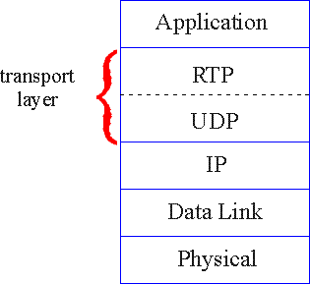
Multimedia Networks
Lecture 16
RTP runs on top of UDP
RTP libraries provide transport-layer interface that extends UDP
Dept. of Computer Science and Engineering, University of Rajshahi

Slide 5
Multimedia Networks
Lecture 16
RTP Example
consider sending 64 kbps PCM-encoded voice over RTP.
application collects encoded data in chunks, e.g., every 20 msec = 160 bytes in a chunk.
audio chunk + RTP header form RTP packet, which is encapsulated in UDP segment
RTP header indicates type of audio encoding in each packet
RTP header also contains sequence numbers, timestamps.
Dept. of Computer Science and Engineering, University of Rajshahi

Slide 6
Multimedia Networks
Lecture 16
RTP and QoS
RTP does not provide any mechanism to ensure timely data delivery or other QoS guarantees.
RTP encapsulation is only seen at end systems (not) by intermediate routers.
routers providing best-effort service, making no special effort to ensure that RTP packets arrive at destination in timely matter.
Dept. of Computer Science and Engineering, University of Rajshahi

Slide 7

Multimedia Networks
Lecture 16
RTP Header
Payload Type (7 bits): Indicates type of encoding currently being used.
Sequence Number (16 bits): Increments by one for each RTP packet sent, and used to detect packet loss and to restore packet sequence.
Timestamp (32 bytes long): The timestamp records the first octet of the packet is sampled; it is set by the sender.
Synchronization Source (SSRC 32 bits long): Identifies source of RTP stream. Each stream in RTP session should have distinct SSRC.
Contributing Source (CSRC 32 bits long): Identifies source of contributors.
Dept. of Computer Science and Engineering, University of Rajshahi

Slide 8
Multimedia Networks
Lecture 16
Real-Time Control Protocol (RTCP)
works in conjunction with RTP.
each participant in RTP session periodically transmits RTCP control packets to all other participants.
each RTCP packet contains sender and/or receiver reports
report statistics useful to application: # packets sent, # packets lost, interarrival jitter, etc.
feedback can be used to control performance
sender may modify its transmissions based on feedback
Dept. of Computer Science and Engineering, University of Rajshahi

Slide 9
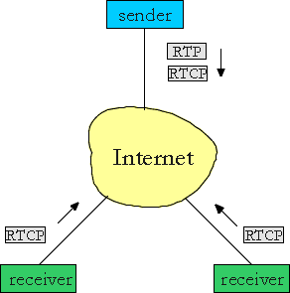
Multimedia Networks
Lecture 16
RTCP - Continued
each RTP session: typically a single multicast address; all RTP /RTCP packets belonging to session use multicast address.
RTP, RTCP packets distinguished from each other via distinct port numbers.
to limit traffic, each participant reduces RTCP traffic as number of conference participants increases
Dept. of Computer Science and Engineering, University of Rajshahi

Slide 10
Multimedia Networks
Lecture 16
RTCP Packets
Receiver report packets:
fraction of packets lost, last sequence number, average interarrival jitter
Sender report packets:
SSRC of RTP stream, current time, number of packets sent, number of bytes sent
Source description packets:
e-mail address of sender, sender's name, SSRC of associated RTP stream
provide mapping between the SSRC and the user/host name
Dept. of Computer Science and Engineering, University of Rajshahi

Slide 11
Multimedia Networks
Lecture 16
RTSP (Real Time Streaming Protocol)
RTSP messages sent out-of-band:
RTSP control messages use different port numbers than media stream: out-of-band.
media stream is considered “in-band”.
RTSP:
client-server application layer protocol
user control: rewind, fast forward, pause, resume, repositioning, etc…
Dept. of Computer Science and Engineering, University of Rajshahi

Slide 12
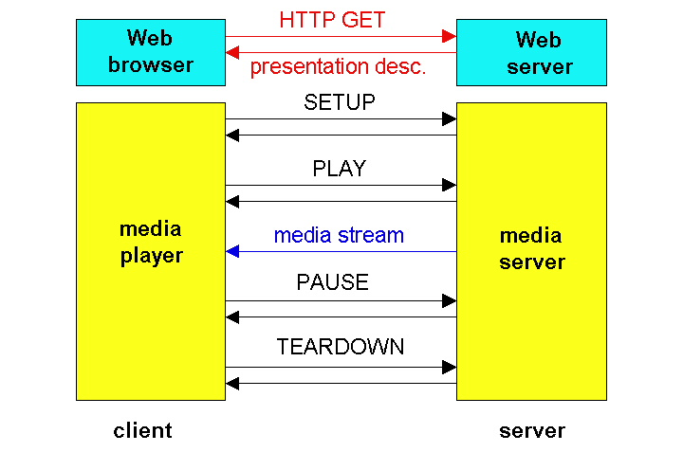
Multimedia Networks
Lecture 16
RTSP Operation
Dept. of Computer Science and Engineering, University of Rajshahi

Slide 13
Multimedia Networks
Lecture 16
RSVP (Resource Reservation Protocol)
RSVP: Resource Reservation Protocol
“ … allow users to communicate requirements to network in robust and efficient way.”
Figure 16.4: A scenario of network resource reservation with RSVP
Dept. of Computer Science and Engineering, University of Rajshahi

Slide 14
Multimedia Networks
Lecture 16
RSVP Design Goals
accommodate heterogeneous receivers (different bandwidth along paths)
accommodate different applications with different resource requirements
make multicast a first class service, with adaptation to multicast group membership
control existing multicast/unicast routing, with adaptation to changes in underlying unicast, multicast routes
control protocol overhead to grow (at worst) linear in # receivers
modular design for heterogeneous underlying technologies
Dept. of Computer Science and Engineering, University of Rajshahi

Slide 15
Multimedia Networks
Lecture 16
RSVP: overview of operation
senders, receiver join a multicast group
done outside of RSVP
senders need not join group
sender-to-network signaling
path message: make sender presence known to routers
path teardown: delete sender’s path state from routers
receiver-to-network signaling
reservation message: reserve resources from sender(s) to receiver
reservation teardown: remove receiver reservations
network-to-end-system signaling
path error
reservation error
Dept. of Computer Science and Engineering, University of Rajshahi

